Slide 1
Presented by : Nik – Shahriar Nikkhah
Date : 2021-09-16
How to optimize Cloud cost?
Azure Well Architected Framework (AWAF)
Azure Cost Optimization.

Slide 2
Thank you
Diponkar Paul
Toronto Data Professionals Community
Toronto SQL PASS
DSI
SQL Data Side Inc.
IoTCoast2Coast.
C Sharp Corner https://www.c-sharpcorner.com/
And thank YOU for attending.

Slide 3
Founders
Nik - Shahriar Nikkhah
Snr. Data Architect/Engineer
Snr. IoT Consultant
C# Corner MVP
Deepak Kaushik
Snr. Cloud Architect
Microsoft MVP
C# Corner MVP

Slide 4

Agenda
Five pillars of Azure Well-Architected Framework (AWAF)
Principles of “Cost Optimization”
List of Cloud resources using KQL and CLI reports for cost optimization. Extracting Service Inventory
Scenario: “AppservicePlan” using Azure CLI
Scenario: Under utilize resources
We will be focusing on the above agenda

Slide 5
Saving Plan Scenario
1,000 + Services (Prod + UAT)
300 + Services (Dev)
Total coast CAD $1,000,000
Saved 40% CAD $600,000
Minimum environmental access
SKU P2 ($1,597) --> B1 ($9.90)
First Day goal… Save 50K or 5%
You have only one day for evaluation.

Slide 6
What is “Azure Well Architected Framework”?
AWAF Enables cloud adaptation success
Design, Build, operationalize, Optimize cloud adoptions
AWAF is an ecosystem to help you to achieve business objectives
Practices, Assessment, technical guidance
WAF review evaluated work loads and identifies areas to focus on.

Slide 7

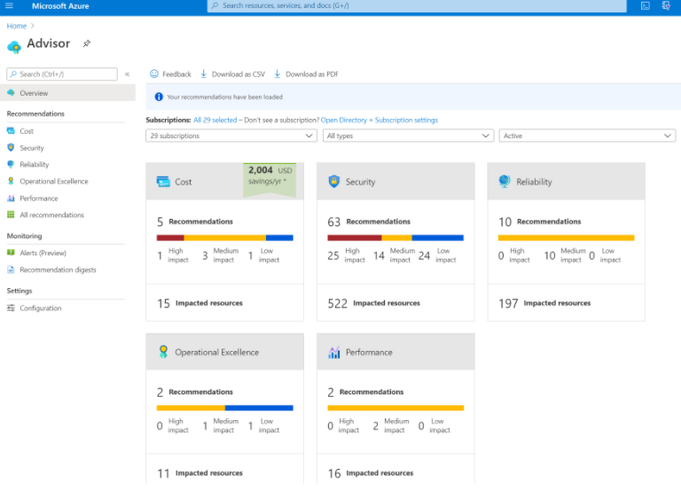
Five pillars of AWAF
Pillar | Description
Cost Optimization | Managing costs to maximize the value delivered.
Operational Excellence | Operations processes that keep a system running in production. Deployments must be reliable and predictable. They should be automated to reduce the chance of human error.
Performance Efficiency | The ability of a system to adapt to changes in load. Vertical scaling :(scaling up) means increasing the capacity of a resource, Horizontal scaling :(scaling out) is adding new instances of a resource
Reliability | The ability of a system to recover from failures and continue to function.
Security | Protecting applications and data from threats.
Using AWAF before and after a turn key project. (Azure Advisor)

Slide 8
Principles of “Cost Optimization”
Business goals driven, Return on investment (ROI), stay within budget.
Keep within the cost
Aim for scalable costs (automatic scaling)
Pay for consumption
Right resources and size
The principles of cost optimization are a series of important considerations that can help achieve both business objectives and cost justification

Slide 9
Cost Optimization Tips
PayAsYouGo, Reserve instances, Non-profit organization
Benefit of licensing
Right sizing, correct Architecting design (Right time)
Shutting down services, resizing (Dev, UAT, Prod)
Impacts like lift and shift. ($↑)
Set Targets (Monthly budget), Variance by Teams groups.
Memorize the cost of each service.
Are you doing the right thing?
Check your cost optimization everyday, measure everyday.

Slide 10
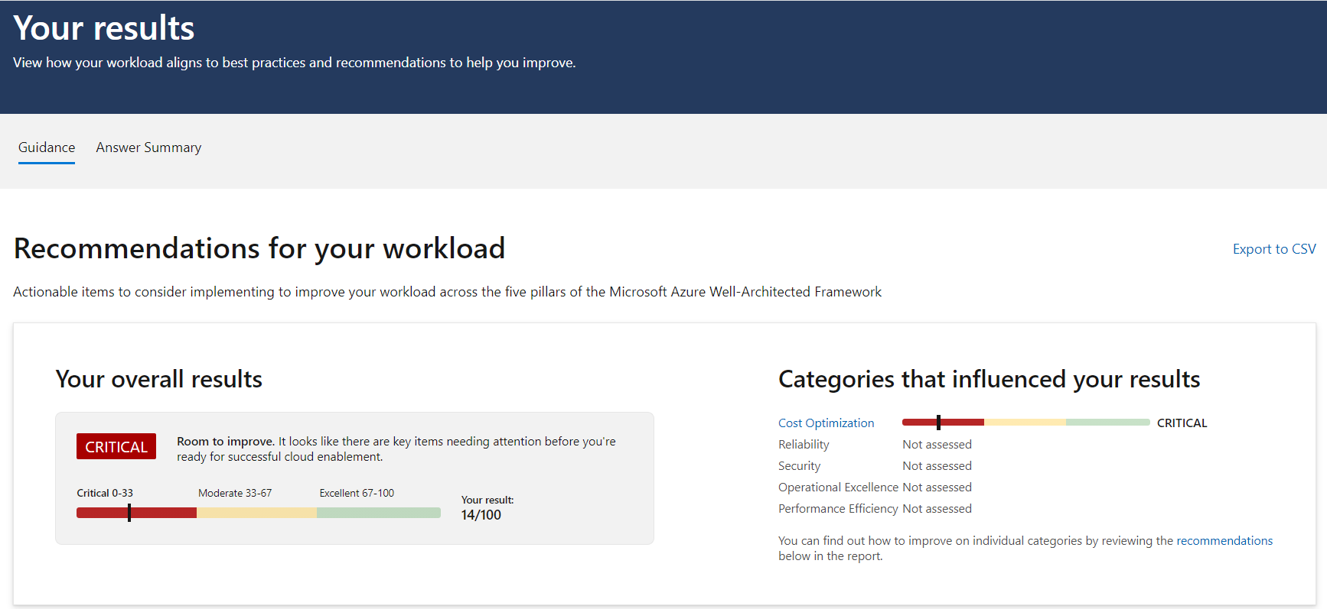
AWAF Review (Assess your services)
.
https://docs.microsoft.com/en-ca/learn/paths/azure-well-architected-framework/
https://azure.microsoft.com/en-us/blog/introducing-the-microsoft-azure-wellarchitected-framework/

Slide 11

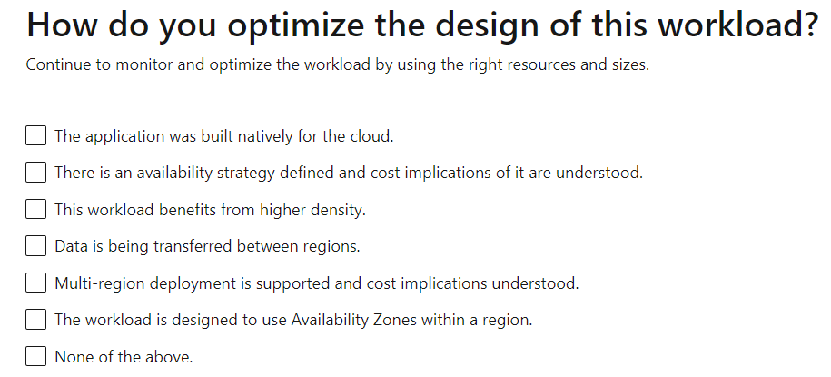
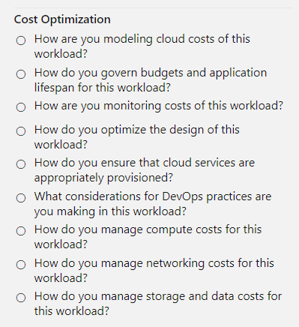
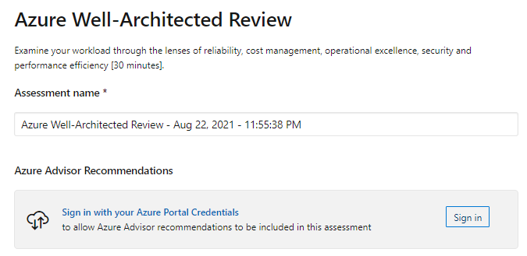
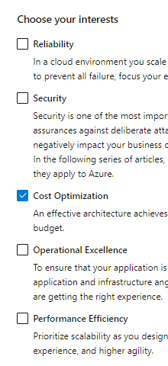
AWAF Review (Cost Optimization)
List of technical and nontechnical questions
Using AWAF for best practices to improve cloud deployment.
Make your own checklist.

Slide 12
Cost Optimization Solutions
Azure Advisor
Azure Migrate tool (Preassessment tool)
Azure Cost Management Tool (Power BI from MS)
API calls (Postman)
List/Custom your AWAF Costs
Third party
Customize your AWAF for each service

Slide 13
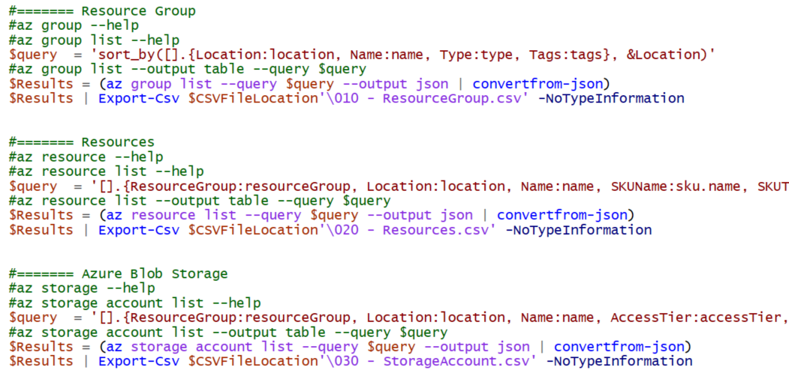
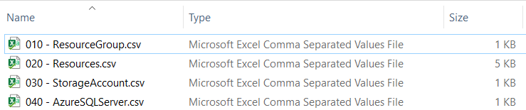
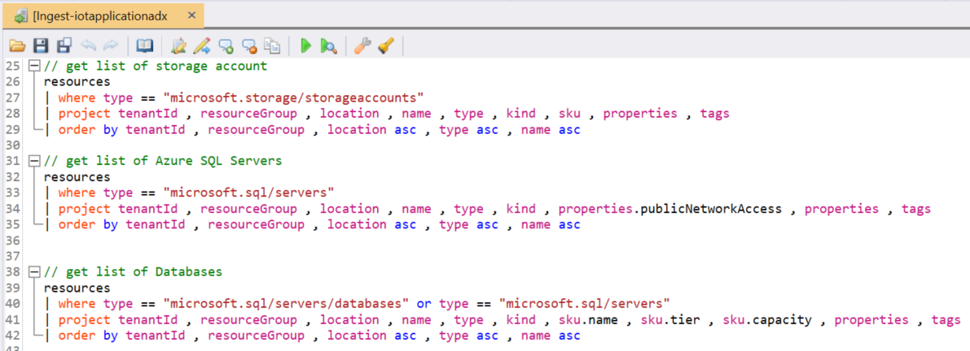
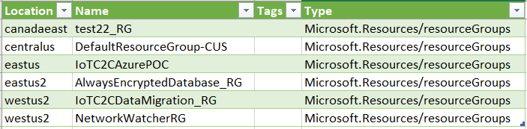
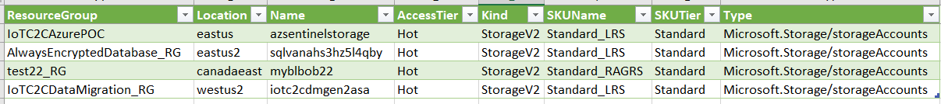
Extracting Service Inventory
.
Azure Cost Management, Cost Alert, Azure Advisor, Tag

Slide 14
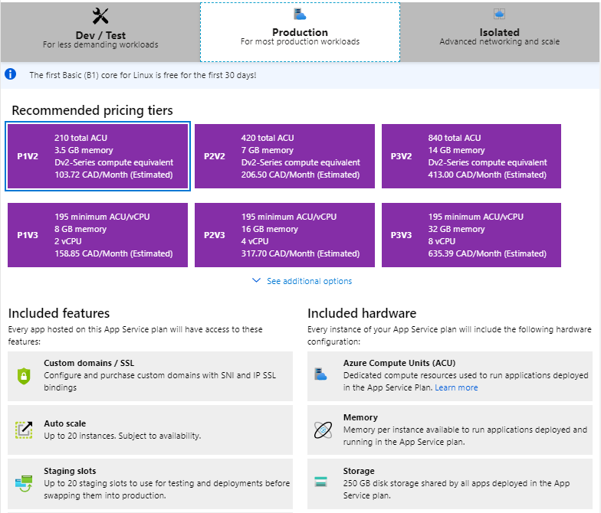
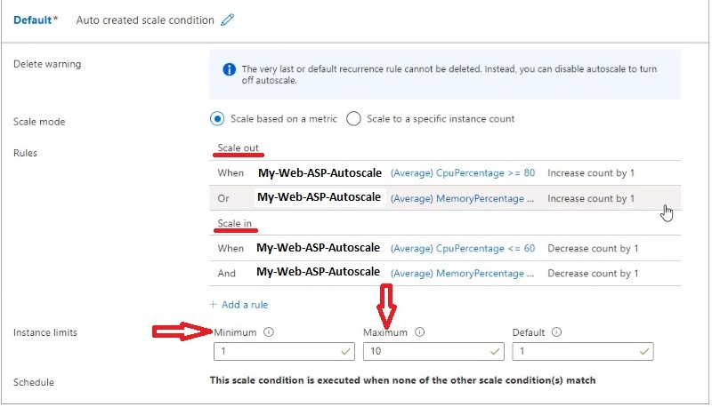
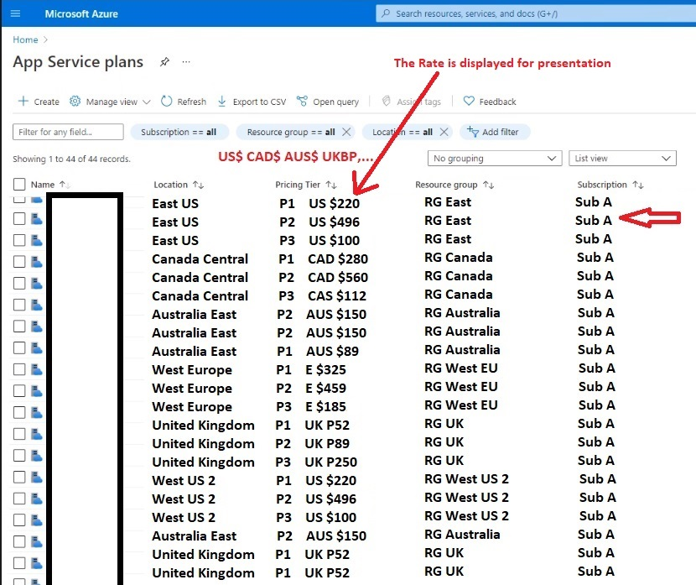
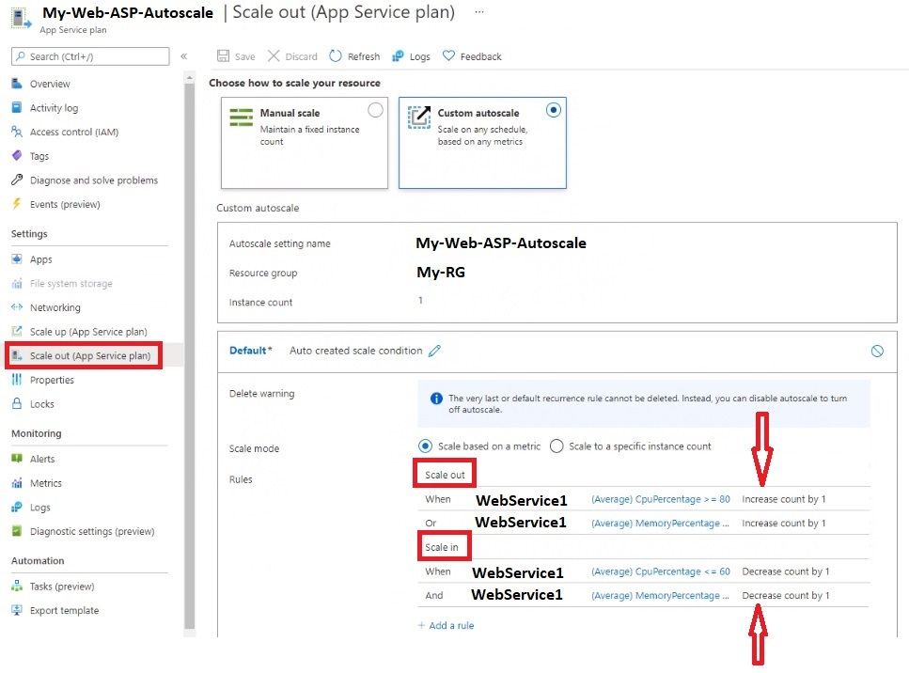
Azure App Service Plan
In App Service (Web Apps, API Apps, or Mobile Apps), an app always runs in an App Service plan
--

Slide 15
Saving Plan Scenario
1,300 + Services
Premium subscription for dev???
Join the … Azure DevTest Labs (Less SLA -- 60%)
Total coast CAD $1,000,000
Saved 40% CAD $600,000
P2 ($1,597) --> B1 ($9.90) – 150 times saving
Tag your services

Slide 16
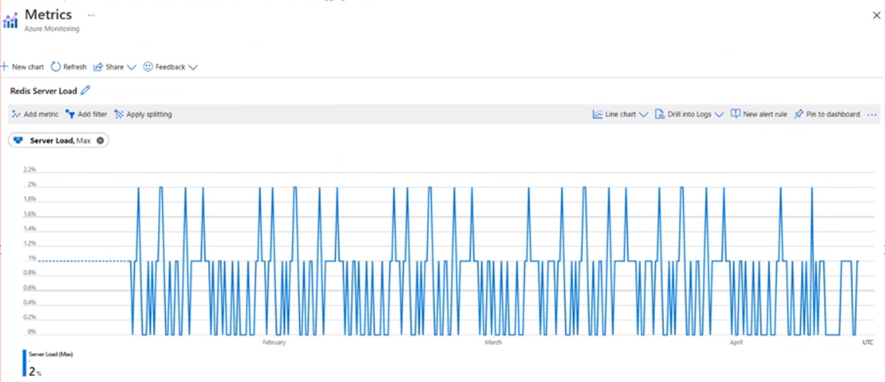
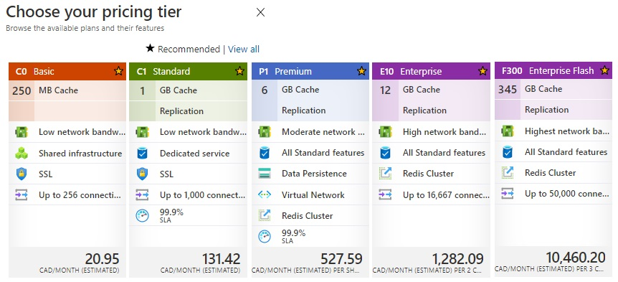
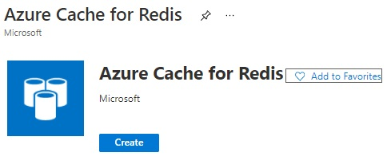
Under utilize resources
Azure Cache for Redis helps your application stay responsive even as user load increases.
It does so by leveraging the low latency, high-throughput capabilities of the Redis engine.
This separate distributed cache layer allows your data tier to scale independently for more efficient use of compute resources in your application layer.
Measure the CPU, Memory, Storage, Growth, Usage, Passthrough… Group(Dev, UAT, Prod), Location, tier, Tag, Update your check list

Slide 17
Thank you
Diponkar Paul
Toronto Data Professionals Community
Toronto SQL PASS
C Sharp Corner
https://www.c-sharpcorner.com/
IoTCoast2Coast
And thank YOU for attending.

Slide 18
Founders
Nik - Shahriar Nikkhah
Snr. Data Architect/Engineer
Snr. IoT Consultant
C# Corner MVP
Deepak Kaushik
Snr. Cloud Architect
Microsoft MVP
C# Corner MVP

Slide 19
Thank You

Slide 20
References
https://azure.microsoft.com/en-us/blog/introducing-the-microsoft-azure-wellarchitected-framework/
https://docs.microsoft.com/en-us/assessments/?mode=pre-assessment&session=0d9db826-6310-4eb3-9fd3-520e17f94032
https://azure.microsoft.com/en-ca/services/cost-management/#overview
https://docs.microsoft.com/en-us/power-bi/connect-data/desktop-connect-azure-cost-management
https://docs.microsoft.com/en-us/rest/api/billing/enterprise/billing-enterprise-api-pricesheet
https://azure.microsoft.com/en-ca/services/devtest-lab/

